Slide 1
Y11 Apps Chapter 7 Skill Development
Pythagoras theorem states that in a right angled triangle, the square of the length of the longest side (hypotenuse) is equal to the sum of the squares of the two shorter sides.
a²
+ b²
= c²
c
a
b

Slide 2
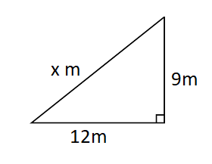
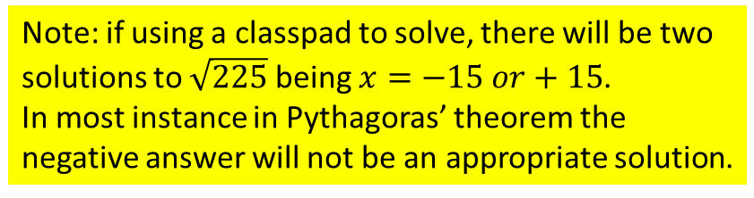
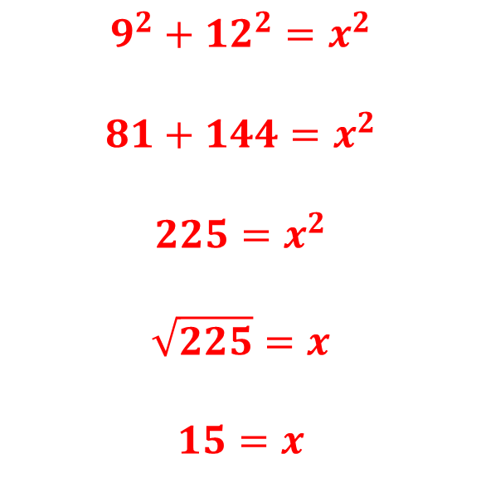
Y11 Apps Chapter 7 Example 1
The right angled triangle shown below has a hypotenuse of length $x$ m.
Find the length of $x$.
$$9^{2}+{12}^{2}=x^{2}$$
$$81+144=x^{2}$$
$${225=x}^{2}$$
$$\sqrt{225}=x$$
$$15=x$$
Note: if using a classpad to solve, there will be two solutions to $\sqrt{225}$ being $x=−15 or+15$.
In most instance in Pythagoras’ theorem the negative answer will not be an appropriate solution.

Slide 3
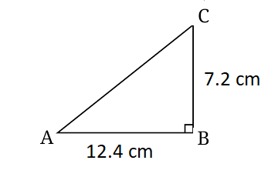
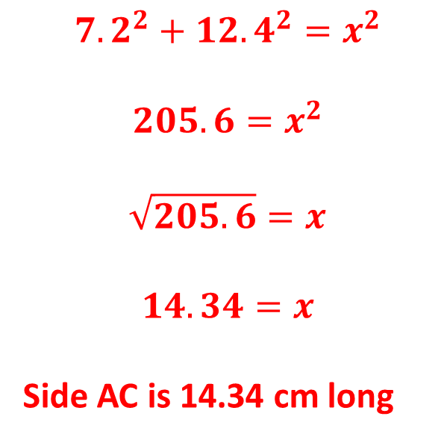
Y11 Apps Chapter 7 Example 2
Find the length of side $AC$ in the right triangle shown below, giving your answer in centimetres, correct to the nearest millimetre.
$${7.2}^{2}+{12.4}^{2}=x^{2}$$
$$205.6=x^{2}$$
$$\sqrt{205.6}=x$$
$$14.34=x$$
Side AC is 14.34 cm long

Slide 4
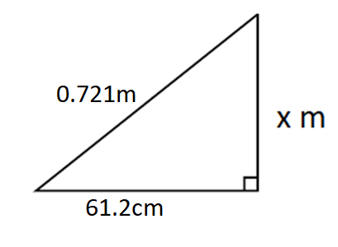
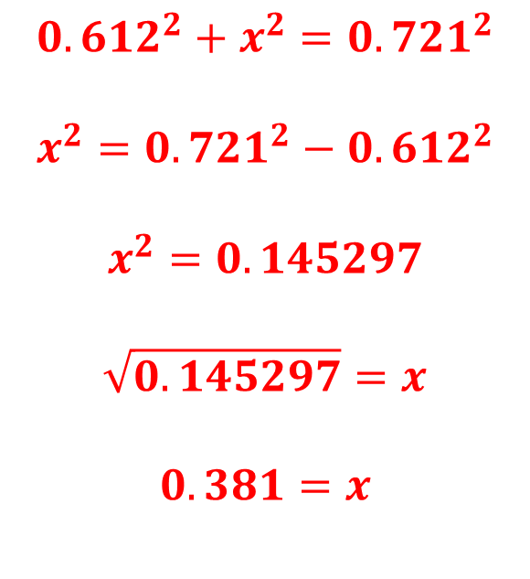
Y11 Apps Chapter 7 Example 3
Find the value of $x$ in the diagram shown below, giving your answer correct to 1 decimal place.
$${0.612}^{2}+x^{2}={0.721}^{2}$$
$$x^{2}={0.721}^{2}−{0.612}^{2}$$
$$x^{2}=0.145297$$
$$\sqrt{0.145297}=x$$
$$0.381=x$$
Convert into m first

Slide 5
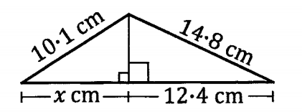
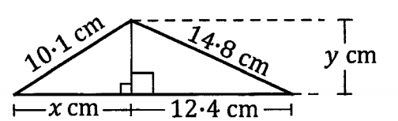
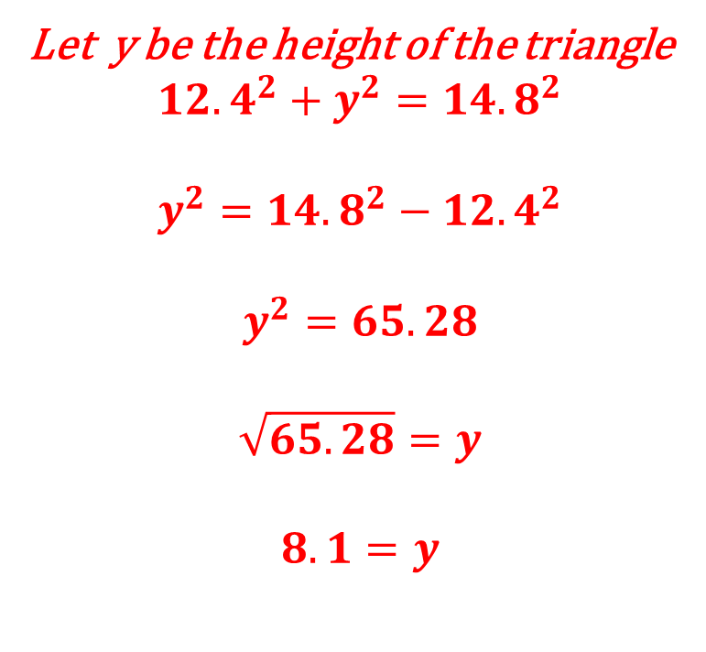
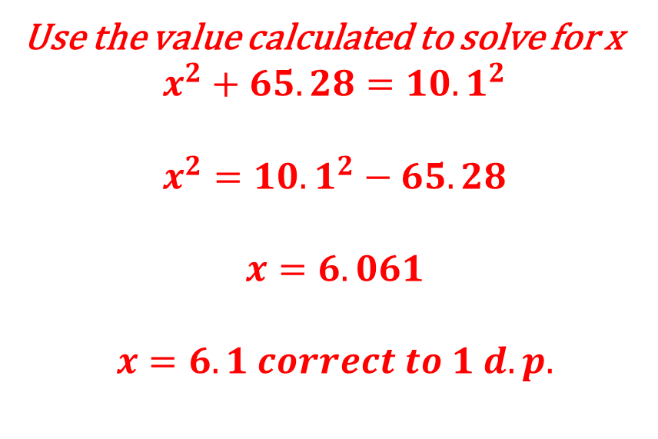
Y11 Apps Chapter 7 Example 4
Now Try Ex 7A
Find the value of $x$ in the diagram shown below, giving your answer correct to one decimal place.
Let y be the height of the triangle
$${12.4}^{2}+y^{2}={14.8}^{2}$$
$$y^{2}={14.8}^{2}−{12.4}^{2}$$
$$y^{2}=65.28$$
$$\sqrt{65.28}=y$$
$$8.1=y$$
Use the value calculated to solve for x
$$x^{2}+65.28={10.1}^{2}$$
$$x^{2}={10.1}^{2}−65.28$$
$$x=6.061$$
$$x=6.1 correct to 1 d.p.$$

Slide 6
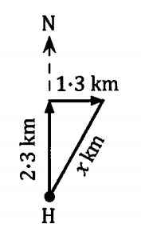
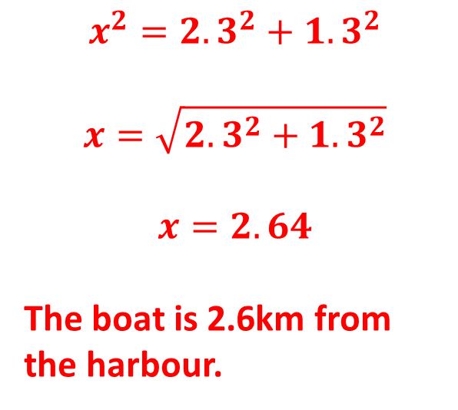
Y11 Apps Chapter 7 Example 5
A boat leaves a harvour, H, and travels 2.3km due North and then 1.3km due East. How far is the boat from the harbour?
$$x^{2}={2.3}^{2}+{1.3}^{2}$$
$$x=\sqrt{{2.3}^{2}+{1.3}^{2}}$$
$$x=2.64$$
The boat is 2.6km from the harbour.

Slide 7
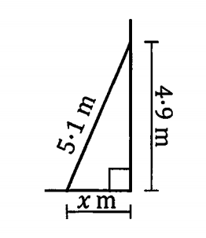
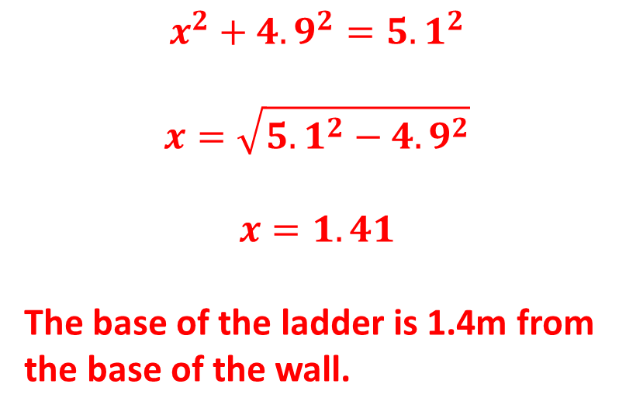
Y11 Apps Chapter 7 Example 5
Now Try Ex 7B
A ladder has its base on level ground and its top resting against a vertical wall. If the ladder is 5.1 metres in length and reaches 4.9 metres up the wall, how far is the foot of the ladder from the base of the wall?
$$x^{2}+{4.9}^{2}={5.1}^{2}$$
$$x=\sqrt{{5.1}^{2}−{4.9}^{2}}$$
$$x=1.41$$
The base of the ladder is 1.4m from the base of the wall.

